Slide 1

Cost (under)Estimation for Software Development
Analogies,
Anecdotes
and Analysis
Notes:
This presentation consists of personal experiences, project analyses and research into the methodology of estimation
In every project, the core question is: what will this cost in terms of time and effort??.
Everyone has responsibility – but no-one wants it!
Ironically, although all team members play a role in the level of complexity, it‘s the programmers who are most often held responsible for the amount of effort required
psychological aspects of cost estimation
Difficulties
Methology
Too much material

Slide 2
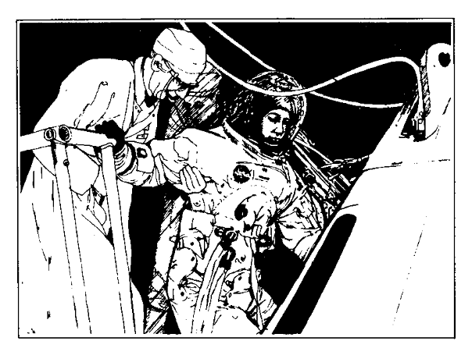
Psychology
It always takes longer than you expect, even when you take
into account Hofstadter's Law. ~ Hofstadter's Law
Programmers are optimists by nature
Each project is seen as a collection of opportunities
Programmers love creating things which work
The digital culture is a trap!
Notes:
There is a subtle satisfaction we feel with every correct output
No I can‘t, yes, I can // loss of face //
This is totally going to work, I‘ll be a hero
Why Psychology? Isn‘t it all algorithms??
If computers and programms all run on numbers, it ought to be possible to mathematically predict the effort involved
We are not changing the water pump in a mercedes. Software projects are unique

Slide 3
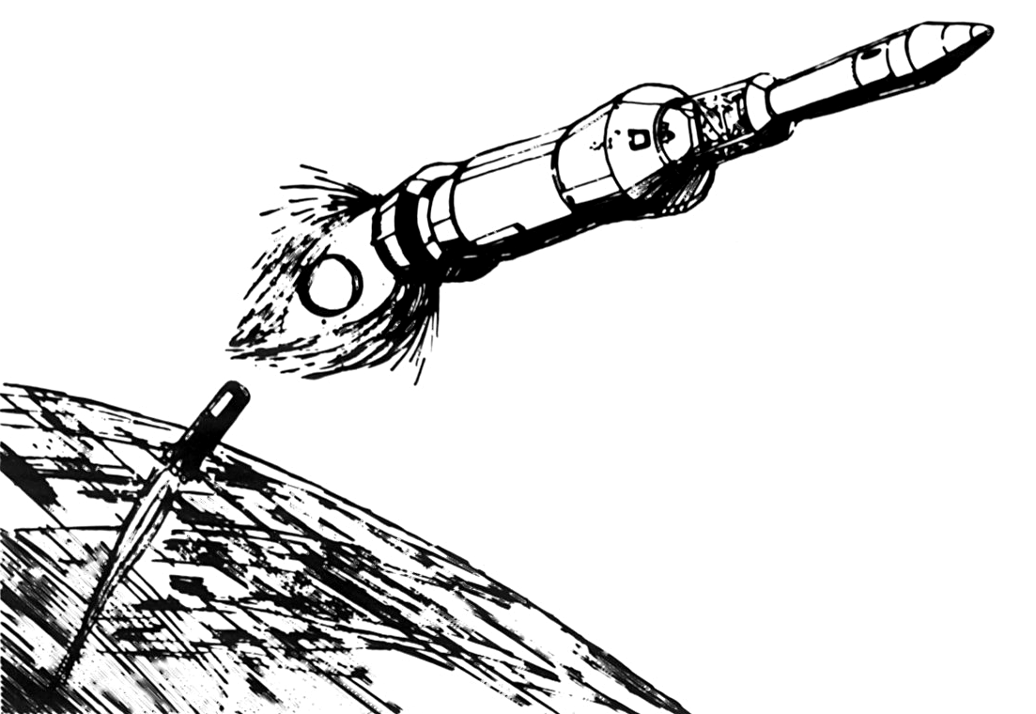
We are certain... ...of uncertainty!
The parameters of the project always change
As projects evolve, they mutate to reflect the growing understanding of their potential.
Known knowns... known unknowns... unknown unknowns ~ Donald Rumsfeld
Notes:
The more detailed the breifing, the more that gets thrown away
What we know,
there are known knowns; there are things we know we know
We also know there are known unknowns; that is to say we know there are some things we do not know.
But there are also unknown unknowns – the ones we don't know we don't know
These unknowns have the most negative influence, because they „appear“ later and later in the project when their impact is greatest
If we did X, we can do Y
Sleeping bag analogy?

Slide 4

Difficulties will arise
Team members are absent (SSS)
Remote or multi-team projects always have connectivity issues
Unproven methods and technologies are often tried
Anything that can go wrong, will go wrong. ~ Murphy‘s Law
Notes:
This is why we don‘t deploy to the live system at five o‘clock on a Friday afternoon!
Finagle's law, related to Murphy's Law, states "Anything that can go wrong, will – at the worst possible time.“
JUST a SAMPLE
Lost time due to employee absences (Sick Symposium Skiing Surfing) // just for sickness, 10%
Technologies evolve. It‘s not unusual to try out new tools in a project: totally cool new framework
They will benefit future projects, but never this one

Slide 5
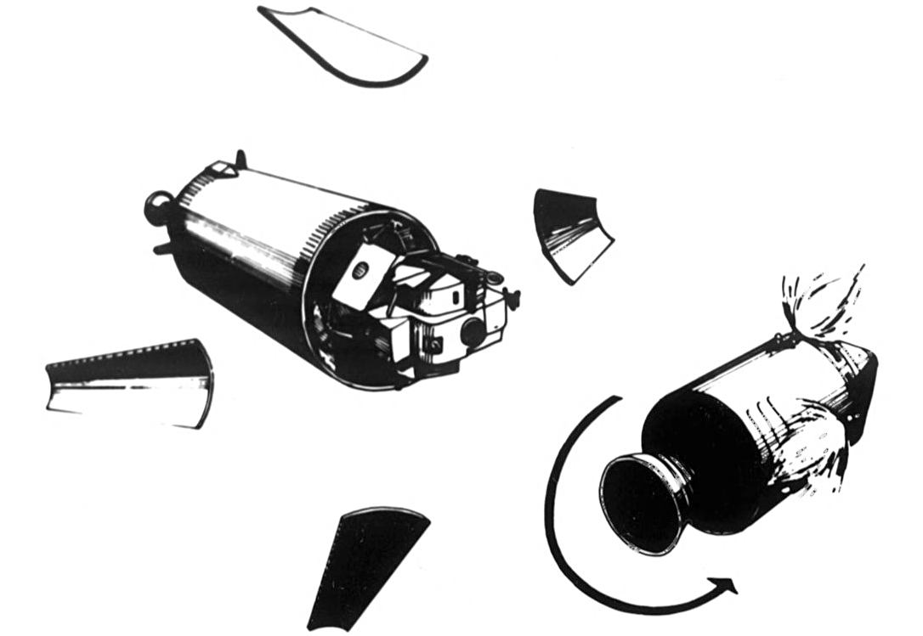
Difficulties in measuring progress
For many phenomena, 80% of consequences stem
from 20% of the causes. ~ Pareto‘s Principle
The measurement of time is not the measurement of progress – burndown is never linear
Actual programming only consumes 16% – 33% of project time
As a corollary, it‘s seldom a good idea to try correcting progress by adding manpower
Notes:
Burn-down is a rollercoaster, with a ramp at the end!
As deadlines near, activity jumps, as do costs
Between 20 lines per hour and 25 lines per day... ...this statement is designed to provoke, but I challenge...
More on manpower adding later...

Slide 6
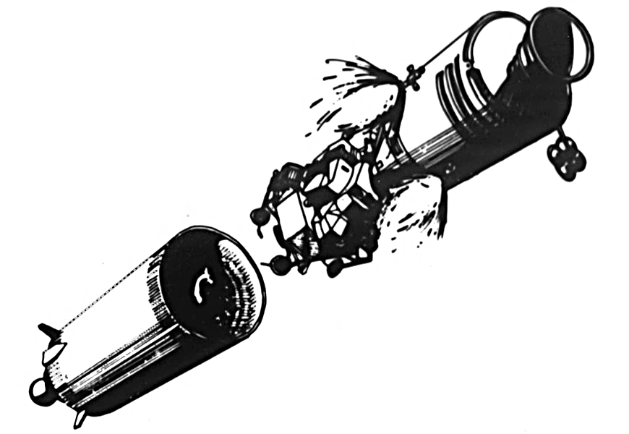
Difficulties in controlling
„The disaster is due to termites, not tornados.“ ~ Fred Brooks
It is difficult to identify incidents which cause delays
Our optimism dictates that small delays can be compensated, although this is rarely the case
„Inconsequent“ or „insignificant“ bits of bad news are often not communicated
Notes:
Oh hello mr client, don‘t you remember the volcano?
Remember that programmers are optimists?
How does a project get to be a year overdue? One day at a time
No-one likes to bear bad news
Too small, not important enough...

Slide 7
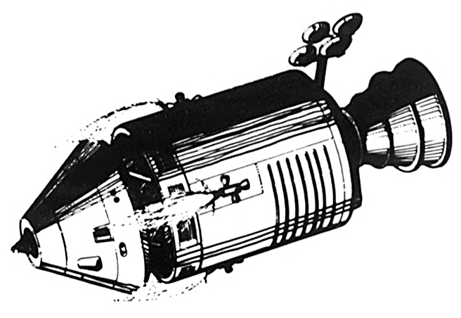
Difficulties in communication
„Communication usually fails, except by accident“ ~ Wiio‘s 1st Law of Communication
It is often impossible for developers to illustrate the complexity of their work
No-one will gladly talk about failure
The perception that potential problems have been adequately communicated is often false
Notes:
Different specialists speak different languages (project modules)
If communication can fail, it will. // murphy
If communication cannot fail, it still most usually fails.
If communication seems to succeed in the intended way, there's a misunderstanding.
If you are content with your message, communication certainly fails.
Ask yourself, have I really communicated?

Slide 8
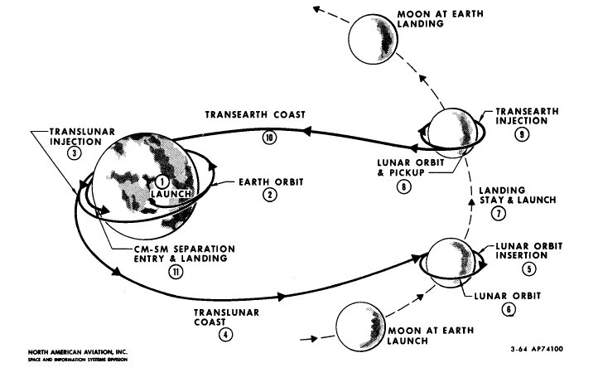
Complexity is always a factor
"A complex system that works is invariably found to have
evolved from a simple system that worked.“ ~ Gall's law
Technical projects are often too complex to be comprehended as a whole
Experience is the best way to mitigate complexity
Fragment difficult tasks until the subtasks are simple
Notes:
Problems are done, now move on to methods
Why only mitigate??
-> Even the realisation that a project is complex is not sufficent to comprehend its complexity
Make all taskes simple, then add them up-→ next slides
Herein lies the key! Estimate complextiy

Slide 9
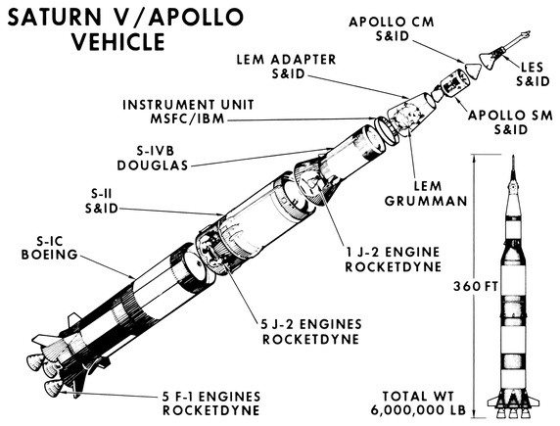
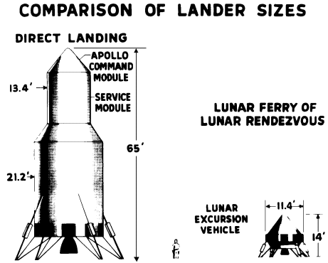
Estimate complexity!
“Life is really simple, but we insist on making it complicated“ ~ Confucius
Complexity is easier to estimate than effort
Map levels of complexity to experience
Estimate comparative values, not absolutes
Notes:
Building height as an analogy
Was the effort spent productively? Junior vs. Senior

Slide 10
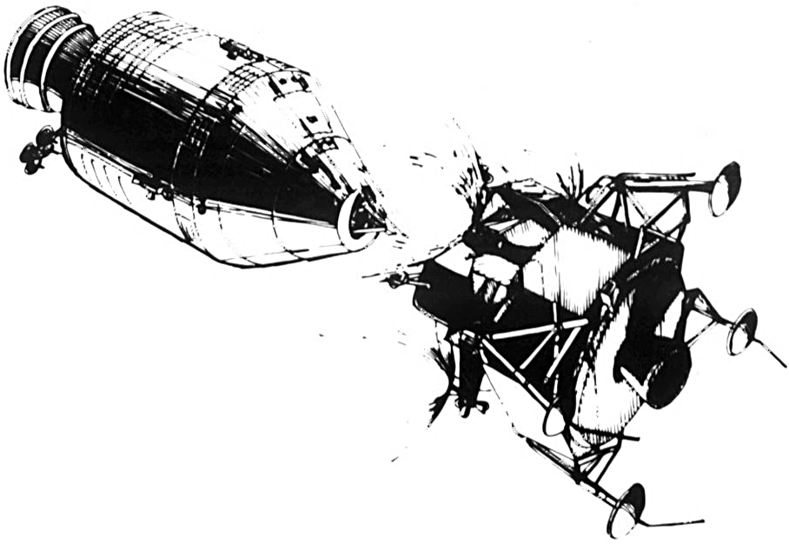
Methodology of Estimation
„Technology is neither good nor bad; nor is it neutral.“
~ Kranzberg's first law of technology
Don‘t rate the algorithms above the human factors
All factors which lead to overruns are human in origin
As a corollary, success will never be caused by the technology
Know the methods, know the people
WTHDTDADAWDICSM(T&M)...???
Notes:
EAF in two more slides
Technology is only a bonus if it is mastered with expertise remeber what I said about new tech
I‘ll be talking about algortihms
What the hell do they do all day and why does it cost so much (T&M)

Slide 11
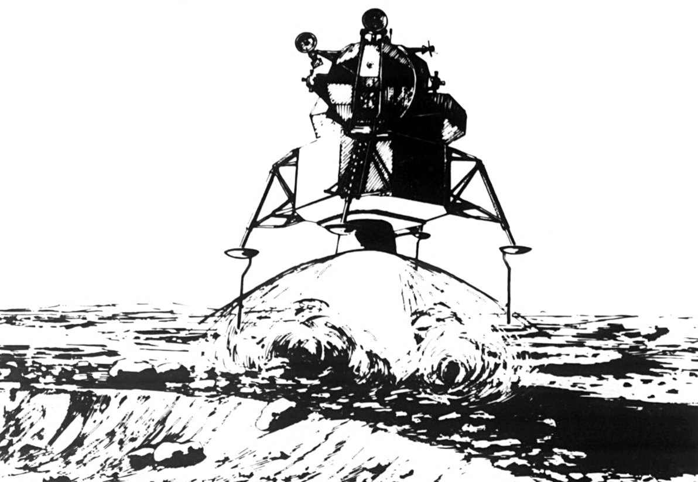
Methodology of Estimation
The most pragmatic method is „Play to win“
Our estimation of what the market will pay often dictates what the job will cost
Learn it, live it, breathe it!
„Budget constraints imply that the values of excess market
demands must sum to zero.“ ~ Walras' law
Notes:
Short excursion into market equilibrium
Message to programmers!!!! Be sensitive of the economics of your work

Slide 12
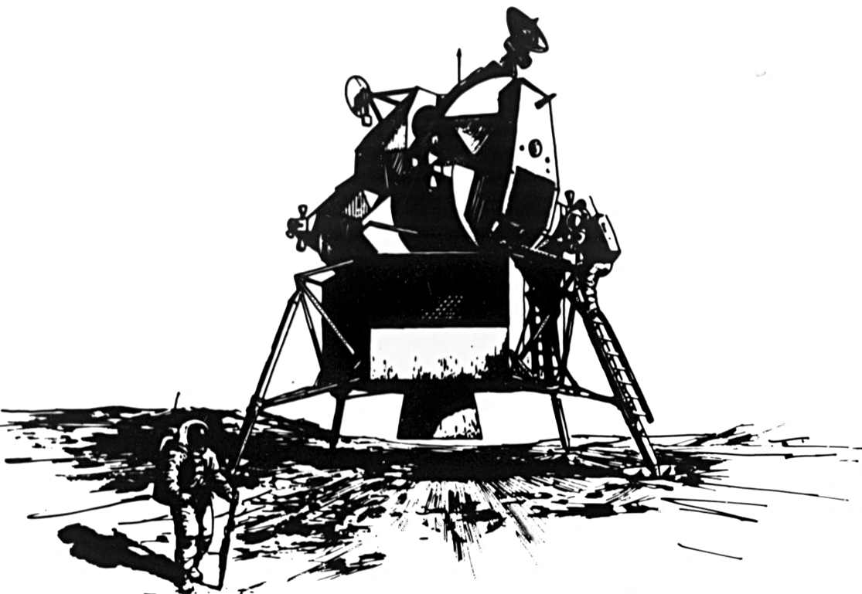
Methodology of Estimation
(algorithmic) Constructive Cost Model (COCOMO)
E = a_{i}(KLoC)^{(b}_{i}⁾(EAF)
Which tools / Which team?
Complicating factors!
„If two objects have all their properties in common,
then they are one and the same object.“ ~ Leibnitz‘s Law
Notes:
A nice, technical-looking algorithm
where E is the effort applied in person-months,
KLoC is the estimated number of thousands of delivered lines of code for the project, and
EAF EAF are Effort Adjustment Factors. (people, unknowns)

Slide 13
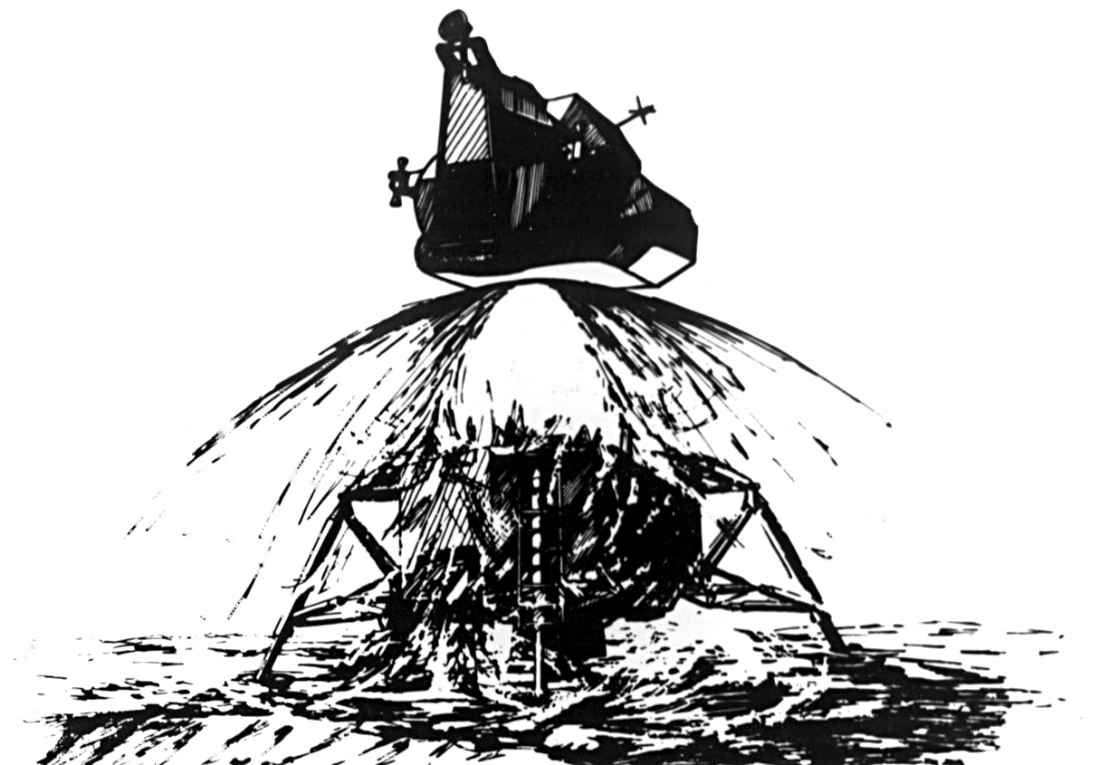
Methodology of Estimation
1 day converts to 3.14 weeks. ~ The Programmer‘s Time Table
Thirty seconds is an hour
From the bottom up: Break the tasks down
Four hours is our target
Referred to as „Scope to time“
Notes:
Project managers! Hands up!
1 week = 3.14 months
Good middle bad - worst case... ...is one for a new developer
Don‘t talk to the bus driver - go ahead talk to the developers, but be aware that if you do, it‘s a time / money factor (project switch)

Slide 14
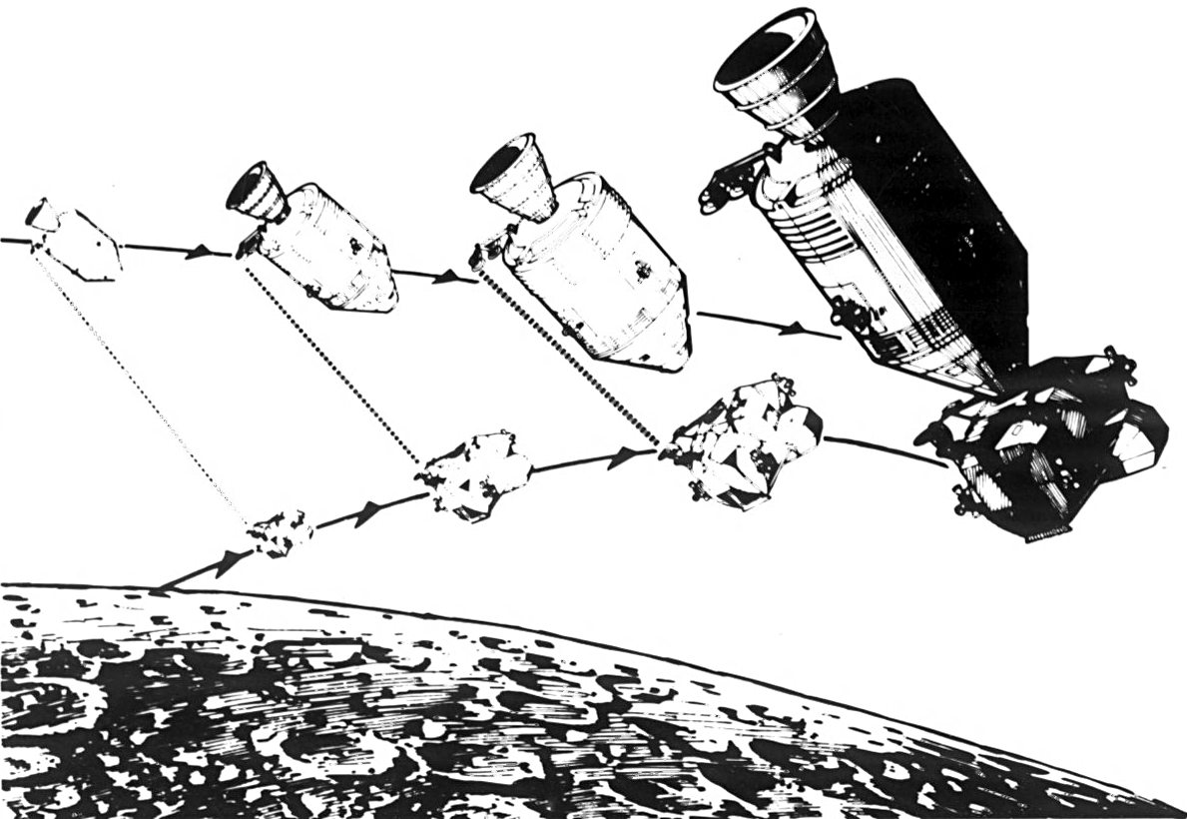
Methodology of Estimation
„The time it takes for a person to make a decision is
a function of the number of possible choices.“ ~ Hick's law
Any tasks which might take longer than eight hours are too complex to estimate and must be split
Eight hours is not a man-day, five hours is!
Plan subtasks for integration, QA and „non-developmental“ jobs
Notes:
Developers need ten minutes to get started – anyone does
GI // GO after eight hours, production slows and becomes detrimental because of refactoring
Start by adding up small tasks and breaking down larger ones

Slide 15
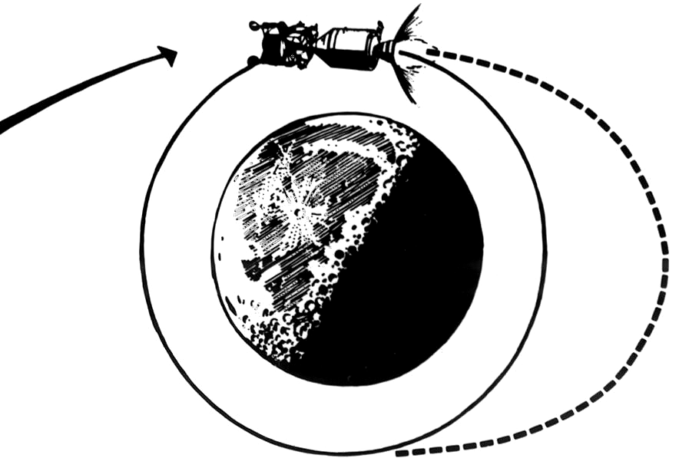
Methodology of Estimation
„Adding manpower to a late software project makes it later.“ ~ Brook's law
Expenses can be calculated using team size multiplied by the duration of the project to provide an estimate in man-days
Headcount method
Some tasks have a minumum duration, independant of team size
Are tasks person-specific?
Notes:
Nine women cannot bear a child in one month
If you have three tasks, which can only be perfomed by one person, parallel development is impossible

Slide 16
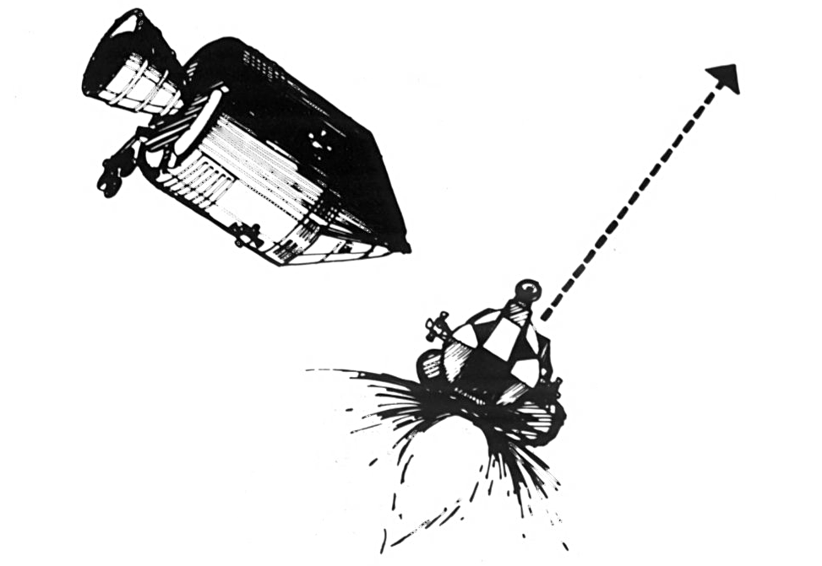
Methodology of Estimation (agile)
„A common mistake that people make when trying to design something completely foolproof is to underestimate the ingenuity of
complete fools.“ ~ Douglas Adams
Estimation is a team job
Strong variations among team members indicate confusion and complexity
Estimation values are comparative and abstract
The results can later be mapped to numbers.

Slide 17
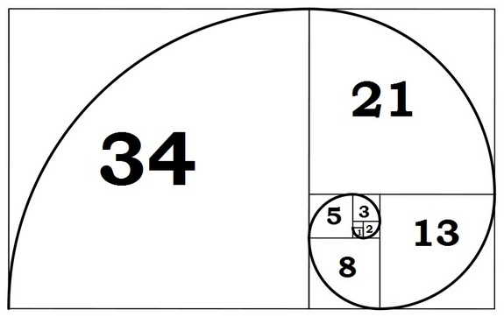
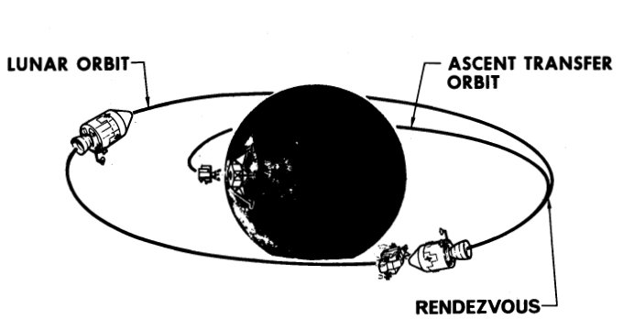
Phyllotaxis, Fibonacci and you
„I demonstrate by means of philosophy that the earth is round, and is inhabited on all sides...“ ~ Johannes Kepler
Planning poker is a method which facilitates comparative estimation.
The abstract numbers force the team to think in small tasks.
Estimate complexity
Estimation becomes a self-correcting, iterative process
Notes:
Short explanation for Phyllotaxis „The order of leaves“
Short explanation of the numbers

Slide 18
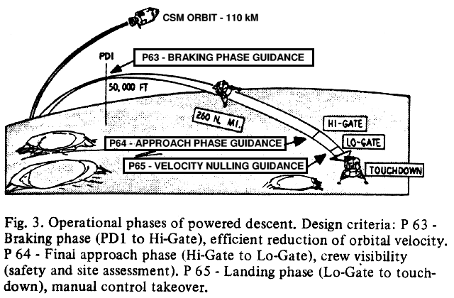
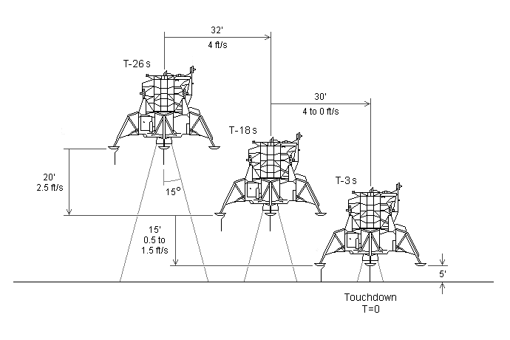
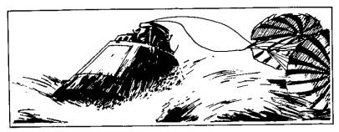
Points + Results = Velocity
„The velocity of light is to the Theory of Relativity as the elementary quantum of action is to the Quantum Theory: it is its absolute core. “ ~ Max Planck
We map the abstract values to reality.
Take the total number of complexity points from the initial sprint.
Compare that to finished tasks vs. backlog at the end of the sprint.
Derive a corrective co-efficient.
Apply that value to the next estimation.
Notes:
The first sprint
Velocity is local, relative, predictive... ...and applies to the entire team

Slide 19
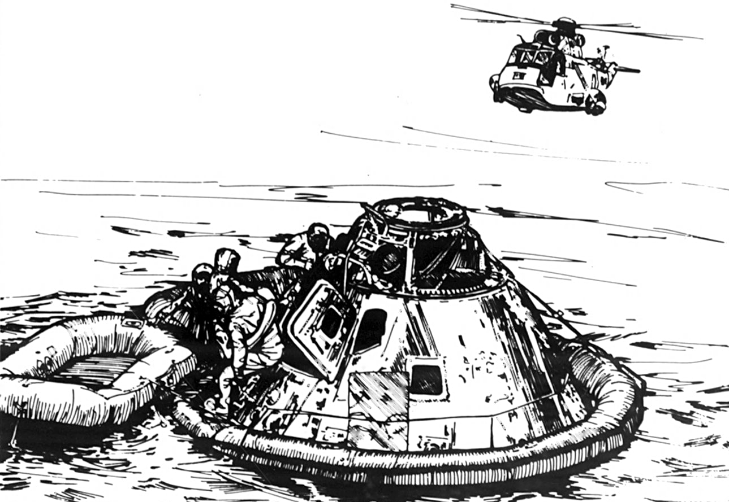
Apollo 11, July 21st, 1969
„That's one small step for man, one giant leap for mankind.“ ~ Neil Armstrong
github.com/chrislgarry/Apollo-11/
$7 Billion estimated
$23.9 Billion spent
Due date: „before the decade is out“
Project duration: eight years
420.8 KloC

Slide 20

Thank You!
Dan Fitzpatrick,
Triplesense Reply

